Slide 1







NOTES
ARTIFICIAL INTELLIGENCE
Machine Learning - Fuzzy Logic
DR ANIS FARIHAN MAT RAFFEI
OER Artificial Intelligence by Anis Farihan Mat Raffei
work is under licensed Creative Commons Attribution-
NonCommercial-NoDerivatives 4.0 International License

Slide 2
OUTLINES
01. Background of Fuzzy Logic
02. Fuzzy Sets
03. Fuzzy Membership Function
04. Fuzzy Rules
05. Fuzzy Inference/Reasoning
2

Slide 3
EXPECTED OUTCOMES
Be able to understand the theories of fuzzy sets, fuzzy operation and fuzzy inference to problems.
Be able to formulate the fuzzy rules and distinguish the main differences between classical and fuzzy rules.
Be able to implement two fuzzy inference techniques – Mamdani and Sugeno – and suggest appropriate areas for their application
3

Slide 4
OUTLINES
01. Background of Fuzzy Logic
02. Fuzzy Sets
03. Fuzzy Membership Function
04. Fuzzy Rules
05. Fuzzy Inference/Reasoning
4

Slide 5
Background of Fuzzy Logic
What is Fuzzy Logic?
Definition of Fuzzy Logic
Where did it begin?
Fuzzy Logic Control System
5

Slide 6
What is Fuzzy Logic?
Definition of Fuzzy
“Not clear, indistinct, blurred, difficult to perceive or vague”
(Source: Cambridge Dictionary)
Fuzzy logic is not logic that is fuzzy, but logic that is used to describe fuzziness.
Fuzzy logic is the theory of fuzzy sets, sets that calibrate vagueness.
Fuzzy logic is based on the idea that all things admit of degrees.
6

Slide 7

Definition of Fuzzy Logic
“Fuzzy logic is determined as a set of mathematical principles for knowledge representation based on degrees of membership rather than on crisp membership of classical binary logic.”
Professor Lotfi A. Zadeh (1965)
Source: Wikipedia
7

Slide 8


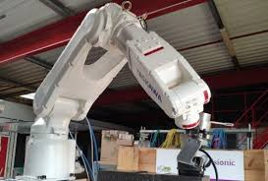


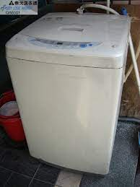


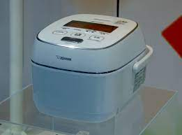
Where did it begin?
First Application of Fuzzy Logic in Control Engineering (Europe)
Empirical Verification of Fuzzy Logic in Europe
Broad Application of Fuzzy Logic in Europe
Fuzzy Logic Becomes a Standard Technology in wide range application areas such as Data, Sensor Signal Analysis, Business, Finance and many more.
1965
1970
1975
1980
1985
1990
1995
2000
NOW
Fuzzy sets were developed by Lotfi Zadeh in response to the perceived difficulty of providing exact inputs to intelligent systems.
Introduction of Fuzzy Logic in Japan
Broad Application of Fuzzy Logic in Japan
Broad Application of Fuzzy Logic in the U.S.
8

Slide 9
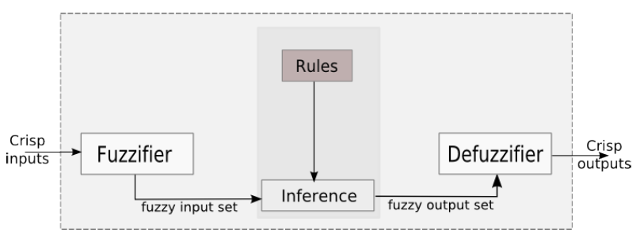
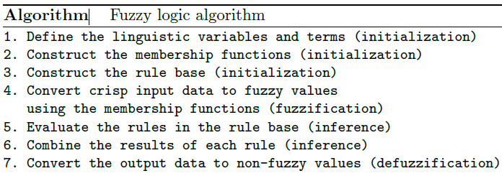
Fuzzy Logic Control System
The fuzzy controller has 4 main components:
The fuzzification interface simply modifies the inputs so that they can be interpreted and compared to the rules in the rule-base.
The “rule-base” holds the knowledge, in the form of a set of rules, of how best to control the system.
The inference mechanism evaluates which control rules are relevant and then decides what the input should be.
The defuzzification interface converts the conclusions reached by the inference mechanism into the crisp outputs.
9
Source: Michael Negnevitsky. Artificial Intelligence: A Guide to Intelligent Systems. Third Edition

Slide 10





Fuzzy Logic Control System
Example:
Crips input
Fuzzifier
Fuzzy system
Defuzifier
Output
It is too hot!
Turn the air conditioner on high
Set the air conditioner at 90% speed
10

Slide 11
OUTLINES
01. Background of Fuzzy Logic
02. Fuzzy Sets
03. Fuzzy Membership Function
04. Fuzzy Rules
05. Fuzzy Inference/Reasoning
11

Slide 12
Fuzzy Sets
Classical sets (Crip sets)
Concept of Fuzzy sets
Crip sets VS Fuzzy sets
Operation of Fuzzy sets
12

Slide 13
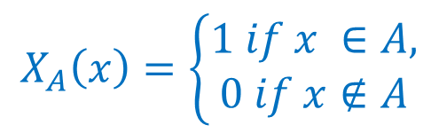
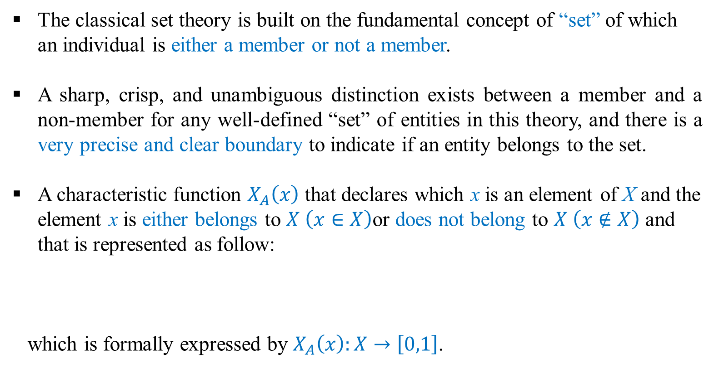
Classical Sets (Crips Sets)
The classical set theory is built on the fundamental concept of “set” of which an individual is either a member or not a member.
A sharp, crisp, and unambiguous distinction exists between a member and a non-member for any well-defined “set” of entities in this theory, and there is a very precise and clear boundary to indicate if an entity belongs to the set.
A characteristic function $X_{A}\left(x\right)$ that declares which x is an element of X and the element x is either belongs to $X \left(x∈X\right)$or does not belong to $X \left(x∉X\right)$and that is represented as follow:
which is formally expressed by $X_{A}\left(x\right):X→\left[0,1\right]$.
$$X_{A}\left(x\right)=\left\{\begin{aligned}1 if x ∈A, \\ 0 if x∉A\end{aligned}\right.$$
13

Slide 14
Classical Sets (Crips Sets)
For deterministic and stochastic cases.
“Is this entity a member of that set?”
“Yes” or “No”
“What is the probability of this entity being a member of that set?”
“The probability for this entity to be a member of that set is 90%”
The final outcome is still either “it is” or “it is not” a member of the set.
For probability and statistics cases.
In the classical set theory, it is not allowed that an element is in a set and not in the set at the same time.
Thus, many real-world application problems cannot be described and handled by the classical set theory, including all those involving elements with only partial membership of a set.
14

Slide 15
Concept of Fuzzy Sets
Fuzzy set, as the name implies, is a set without a crisp boundary.
Fuzzy set theory accepts partial memberships, and, therefore, in a sense generalizes the classical set theory to some extent.
Just as a crisp set on a universal set X is defined by its characteristic function while X to {0, 1}, while a fuzzy set on a domain X is defined by its membership function from X to [0, 1].
A fuzzy set expresses the degree to which an element belongs to a set.
The characteristic function of a fuzzy set is allowed to have values between 0 and 1, which denotes the degree of membership of an element in a given set.
15

Slide 16
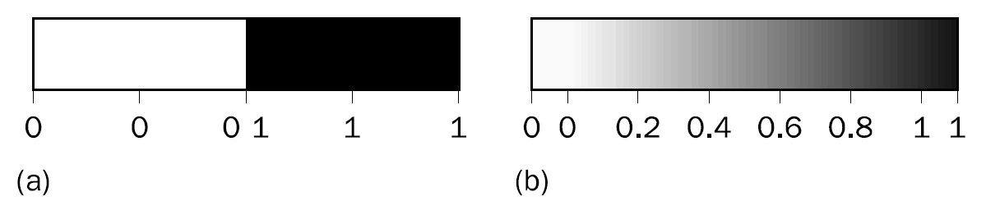
Concept of Fuzzy Sets
Figure 4.1 Range of logical values in Boolean and fuzzy logic:
(a) Boolean logic; (b) multivalued logic
Source: Michael Negnevitsky. Artificial Intelligence: A Guide to Intelligent Systems. Third Edition
Unlike two-valued Crips sets, fuzzy logic is multi-valued.
Fuzzy logic deals with degrees of membership and degrees of truth.
Fuzzy logic uses the continuum of logical values between 0 (completely false) and 1 (completely true).
Instead of just black and white, it employs the spectrum of colours, accepting that things can be partly true and partly false at the same time.
16

Slide 17
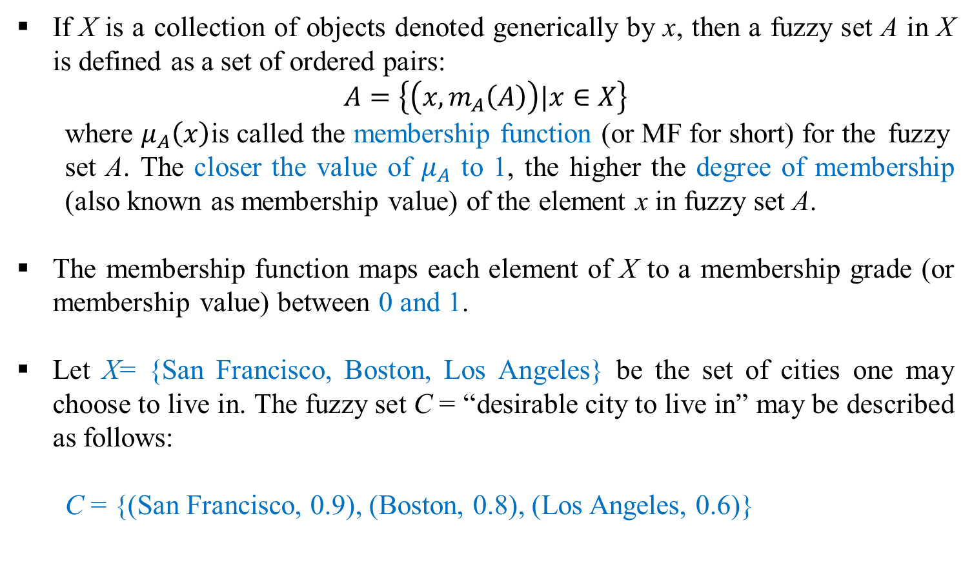
Concept of Fuzzy Sets
If X is a collection of objects denoted generically by x, then a fuzzy set A in X is defined as a set of ordered pairs:
$$Α=\left\{\left(x,m_{A}\left(A\right)\right)|x∈X\right\}$$
where $μ_{A}\left(x\right)$is called the membership function (or MF for short) for the fuzzy set A. The closer the value of $μ_{A}$ to 1, the higher the degree of membership (also known as membership value) of the element x in fuzzy set A.
The membership function maps each element of X to a membership grade (or membership value) between 0 and 1.
Let X= {San Francisco, Boston, Los Angeles} be the set of cities one may choose to live in. The fuzzy set C = “desirable city to live in” may be described as follows:
C = {(San Francisco, 0.9), (Boston, 0.8), (Los Angeles, 0.6)}
17

Slide 18
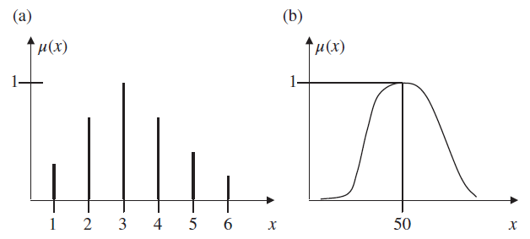
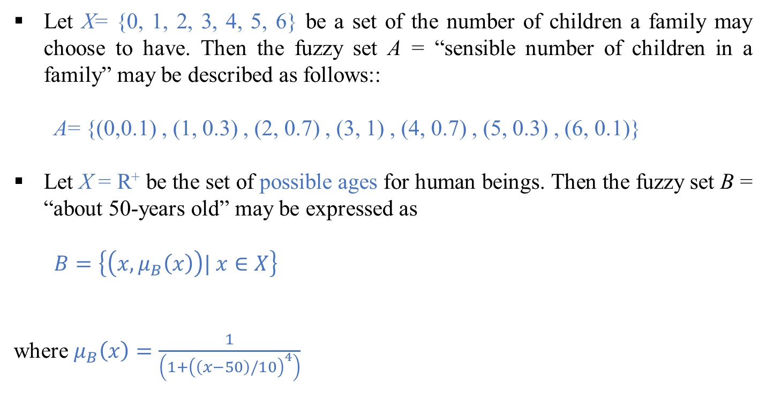
Concept of Fuzzy Sets
Let X= {0, 1, 2, 3, 4, 5, 6} be a set of the number of children a family may choose to have. Then the fuzzy set A = “sensible number of children in a family” may be described as follows::
A= {(0,0.1) , (1, 0.3) , (2, 0.7) , (3, 1) , (4, 0.7) , (5, 0.3) , (6, 0.1)}
Let X = R⁺ be the set of possible ages for human beings. Then the fuzzy set B = “about 50-years old” may be expressed as
$Β=\left\{\left(x,μ_{B}\left(x\right)\right)| x∈X\right\}$
where $μ_{B}\left(x\right)=\frac{1}{\left(1+{\left(\left(x−50\right)/10\right)}^{4}\right)}$
Figure 14.1. Discrete and continuous representation of membership functions for given
fuzzy sets. (a) A = “sensible number of children”. (b) B = “about 50 years old.”
Source: Mehmed Kantardzic. Data Mining Concepts, Models, Methods and Algorithms. Third Edition
18

Slide 19
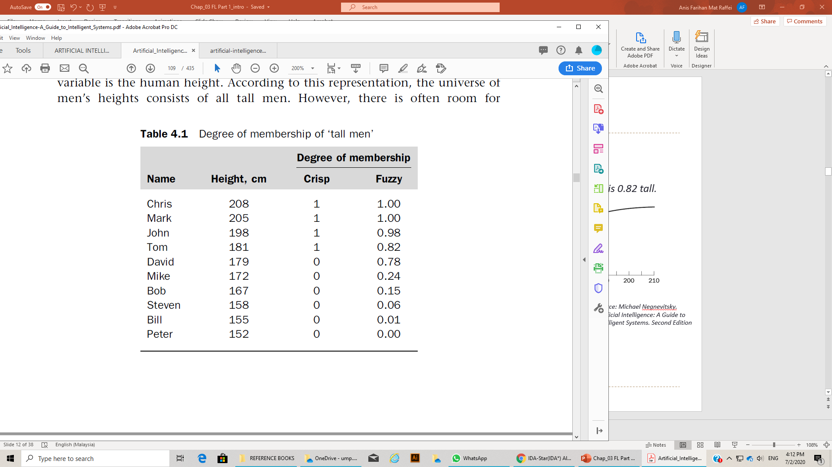
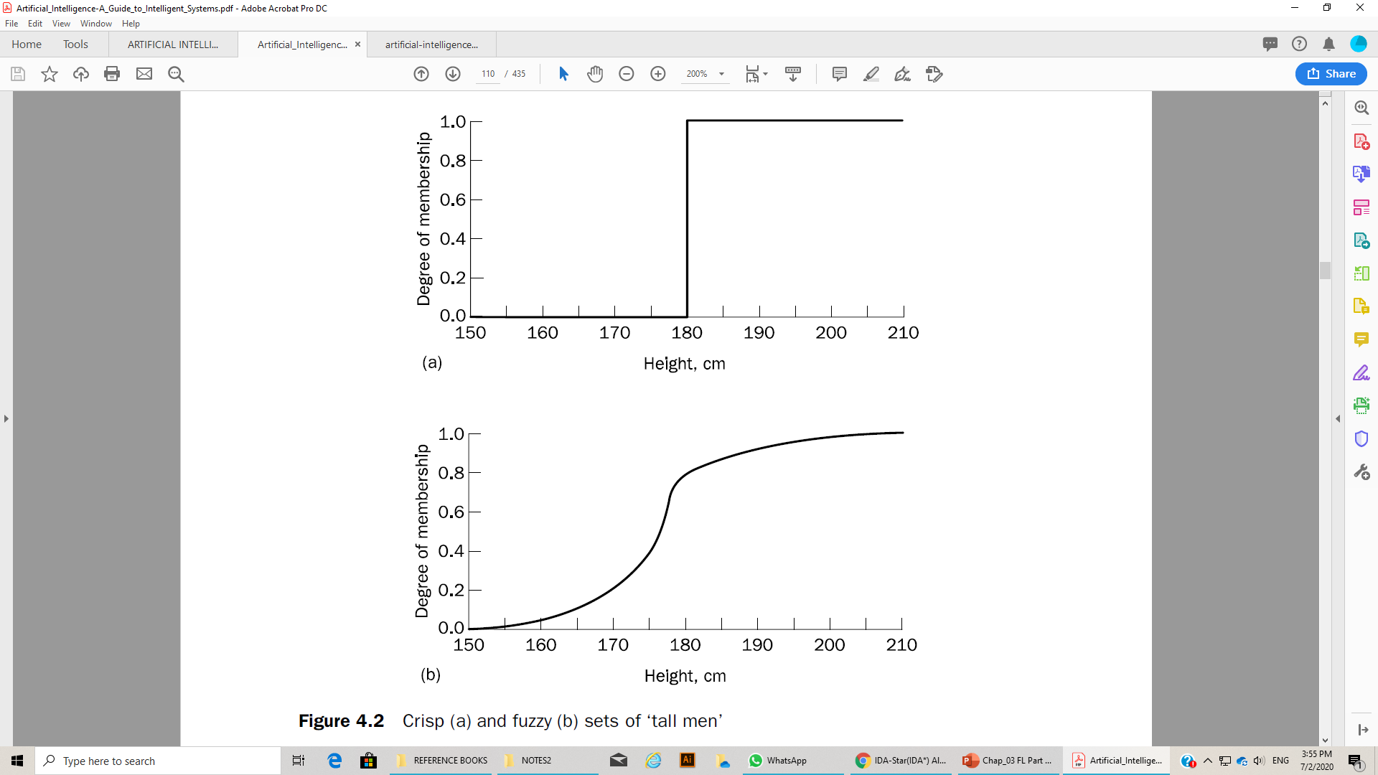
Crisp Sets VS Fuzzy Sets
The crisp set asks: “Is the man tall?” and draws a line at, say, 180 cm.
The answer is tall men are above 180 and not tall men below this height
The fuzzy set asks: “How tall is the man?”
The answer is the partial membership in the fuzzy set, for example, Tom is 0.82 tall.
As can be seen from Figure 4.2, David who is 179 cm tall, which is just 2 cm less than Tom, no longer suddenly becomes a not tall (or short) man (as he would in crisp sets). Now David and other men are gradually removed from the set of ‘tall men’ according to the decrease of their heights.
Figure 4.2 Crisp (a) and fuzzy (b) sets of ‘tall men’
19
Source: Michael Negnevitsky. Artificial Intelligence: A Guide to Intelligent Systems. Third Edition

Slide 20
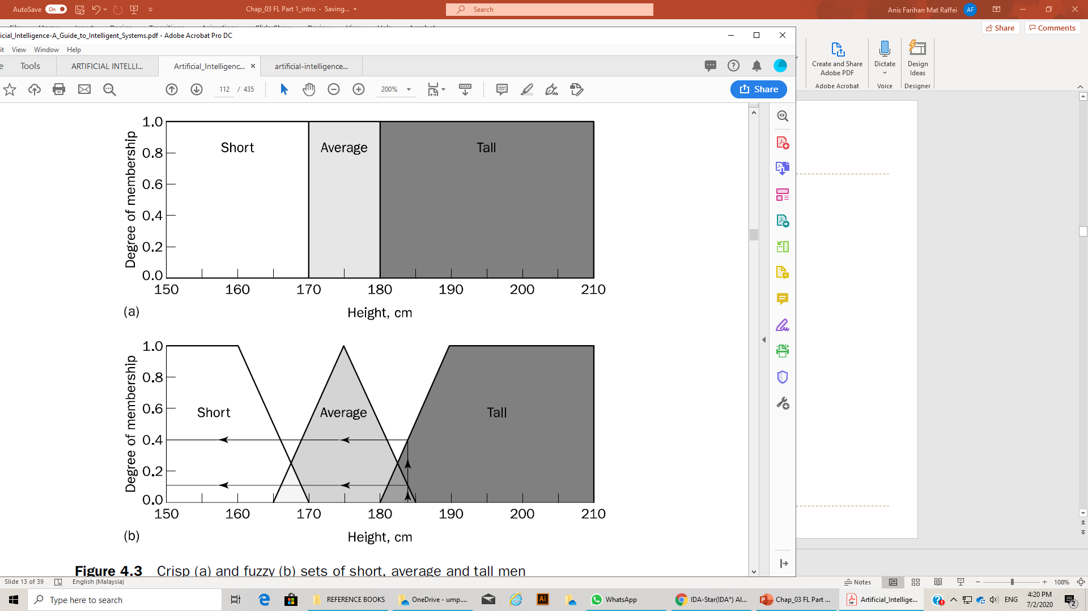
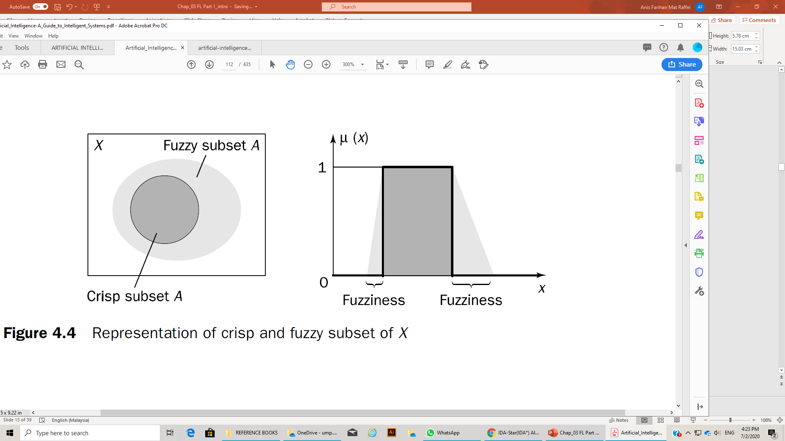
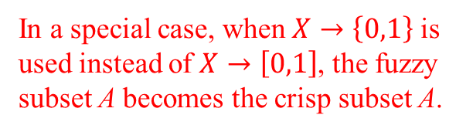
Crisp Sets VS Fuzzy Sets
Figure 4.3 Crisp (a) and fuzzy (b) sets of short, average and tall men
In a special case, when $X→\left\{0,1\right\}$ is used instead of $X→\left[0,1\right]$, the fuzzy subset A becomes the crisp subset A.
Figure 4.4 Representation of crisp and fuzzy subset of X
20
Source: Michael Negnevitsky. Artificial Intelligence: A Guide to Intelligent Systems. Third Edition

Slide 21
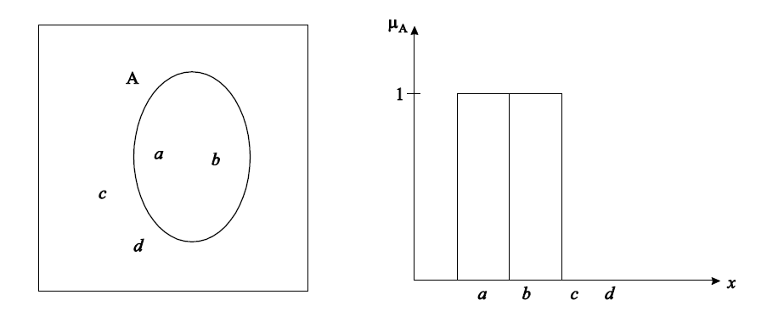
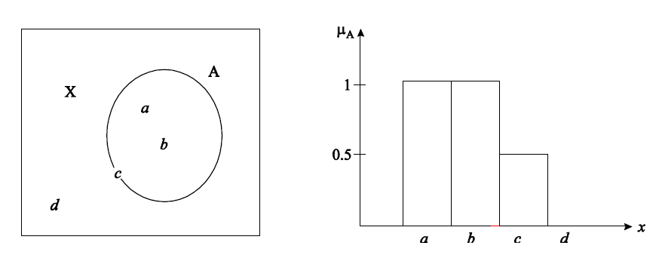
Crisp Sets VS Fuzzy Sets
Figure 1.4: Graphical representation of crisp set
Figure 1.5: Graphical representation of fuzzy set
21
Source: D.S. Hooda and Vivek Raich. Fuzzy Logic Models and Fuzzy Control - An Introduction. First Edition

Slide 22
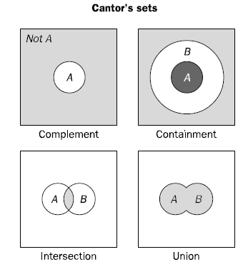
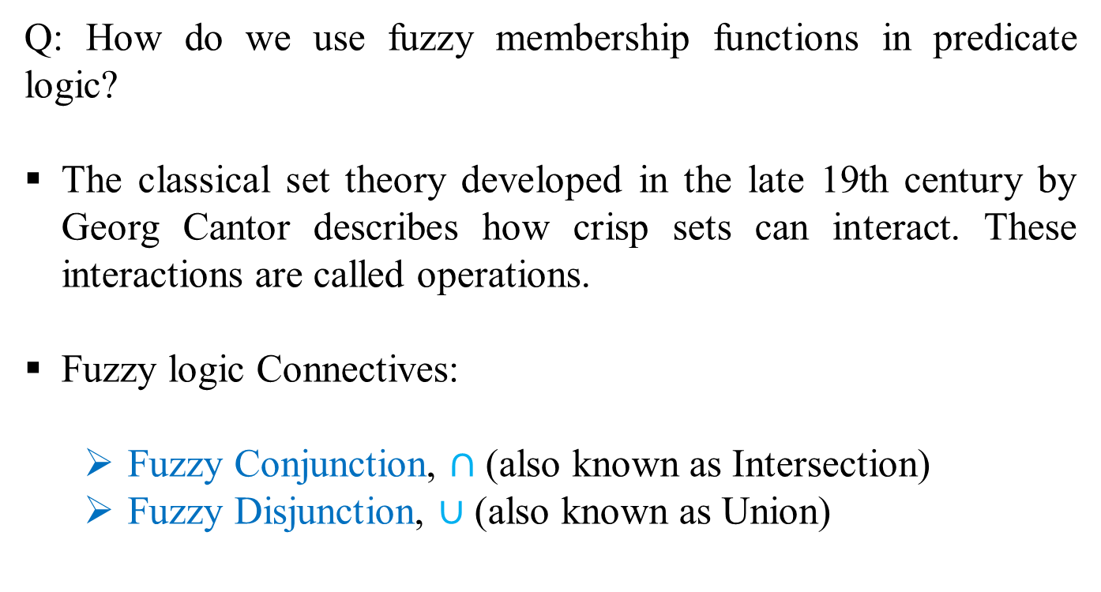
Operations of Fuzzy Sets
Q: How do we use fuzzy membership functions in predicate logic?
The classical set theory developed in the late 19th century by Georg Cantor describes how crisp sets can interact. These interactions are called operations.
Fuzzy logic Connectives:
Fuzzy Conjunction, $∩$ (also known as Intersection)
Fuzzy Disjunction, $∪$ (also known as Union)
Source: Michael Negnevitsky. Artificial Intelligence: A Guide to Intelligent Systems. Third Edition
22

Slide 23
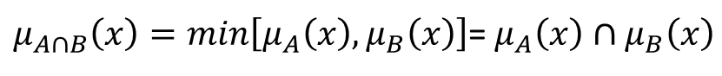


Operations of Fuzzy Sets (Intersection)
A$∩$B = C
"Quality C is the conjunction of Quality A and B"
“Which element belongs to both sets?”
“How much of the element is in both sets?”
Crisp Sets
Fuzzy Sets
In classical set theory, an intersection between two sets contains the elements shared by these sets. If we have, for example, the set of tall men and the set of fat men, the intersection is the area where these sets overlap, i.e. Tom is in the intersection only if he is tall AND fat.
In fuzzy sets, however, an element may partly belong to both sets with different memberships. Thus, a fuzzy intersection is the lower membership in both sets of each element.
(A $∩$ B = C) ⇒ (C = 0.375)
$μ_{A∩B}\left(x\right)=min\left[μ_{A}\left(x\right),μ_{B}\left(x\right)\right]$= $μ_{A}\left(x\right)∩μ_{B}\left(x\right)$
23

Slide 24
Operations of Fuzzy Sets (Question)
Calculate A $∩$ B given that A is .4 and B is 20
24

Slide 25
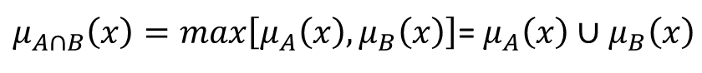


Operations of Fuzzy Sets (Union)
A$∪$B = C
"Quality C is the disjunction of Quality A and B"
“Which element belongs to either set?”
“How much of the element is in either set?”
Crisp Sets
Fuzzy Sets
The union of two crisp sets consists of every element that falls into either set. For example, the union of tall men and fat men contains all men who are tall OR fat, i.e. Tom is in the union since he is tall, and it does not matter whether he is fat or not.
In fuzzy sets, the union is the reverse of the intersection. That is, the union is the largest membership value of the element in either set.
(A $∪$ B = C) ⇒ (C = 0.75)
$μ_{A∩B}\left(x\right)=max\left[μ_{A}\left(x\right),μ_{B}\left(x\right)\right]$= $μ_{A}\left(x\right)∪μ_{B}\left(x\right)$
25

Slide 26
Operations of Fuzzy Sets (Question)
Calculate A $∪$ B given that A is .7 and B is 15
26

Slide 27
OUTLINES
01. Background of Fuzzy Logic
02. Fuzzy Sets
03. Fuzzy Membership Function
04. Fuzzy Rules
05. Fuzzy Inference/Reasoning
27

Slide 28
Fuzzy Membership Function
Types of Fuzzy Membership Functions
Fuzzy Linguistic Variables & Hedges
28

Slide 29
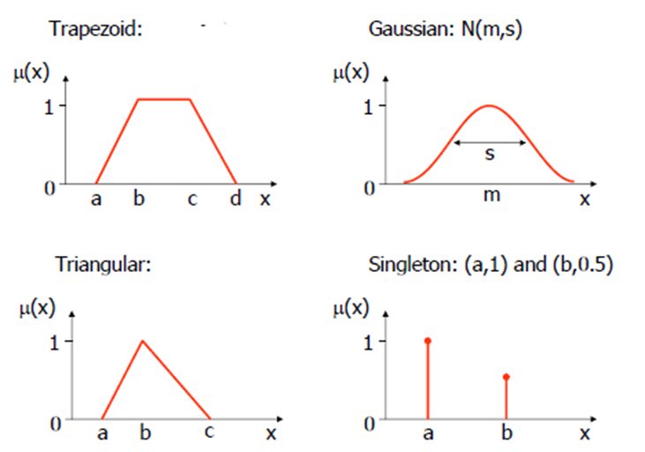
Types of Fuzzy Membership Functions
The membership function defines the degree of membership to a fuzzy set.
Source: Michael Negnevitsky. Artificial Intelligence: A Guide to Intelligent Systems. Third Edition
29

Slide 30
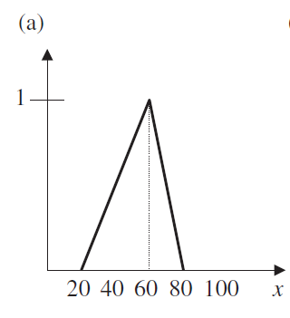
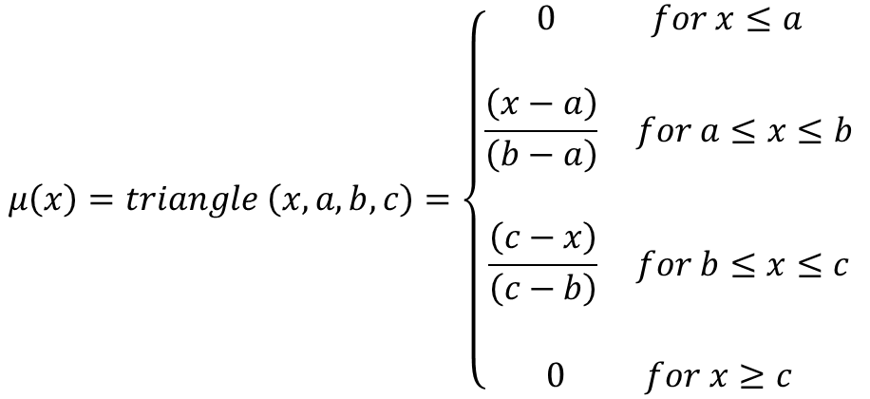
Types of Fuzzy Membership Functions (Triangular)
$$μ\left(x\right)=triangle \left(x, a, b, c\right)=\left\{\begin{aligned}0 for x≤a \\ \\ \frac{\left(x−a\right)}{\left(b−a\right)} for a≤x≤b \\ \\ \frac{\left(c−x\right)}{\left(c−b\right)} for b≤x≤c \\ \\ 0 for x≥c\end{aligned} \right.$$
Eg:
Q: What is the fuzzy value if x=60?
30

Slide 31
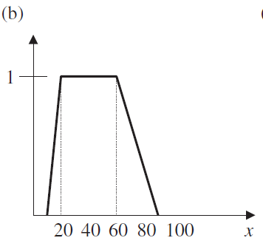
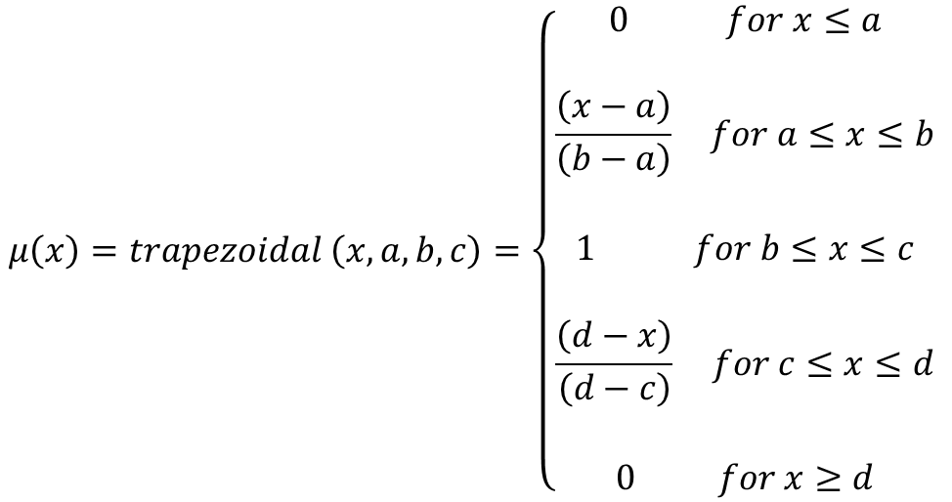
Types of Fuzzy Membership Functions (Trapezoidal)
$$μ\left(x\right)=trapezoidal \left(x, a, b, c\right)=\left\{\begin{aligned}0 for x≤a \\ \\ \frac{\left(x−a\right)}{\left(b−a\right)} for a≤x≤b \\ \\ 1 for b≤x≤c \\ \\ \frac{\left(d−x\right)}{\left(d−c\right)} for c≤x≤d \\ \\ 0 for x≥d\end{aligned} \right.$$
Eg:
Q: What is the fuzzy value if x=60?
31

Slide 32
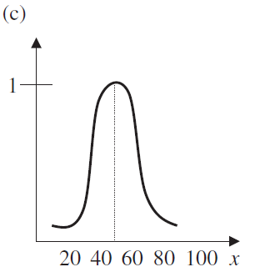
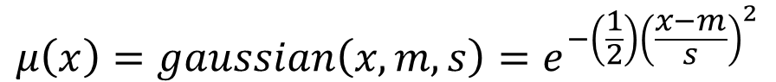
Types of Fuzzy Membership Functions (Gaussian)
Gaussian membership function is specified by two parameters {m, s}:
A Gaussian membership function is determined completely by m and s; m represents the membership-function center, and s determines the membership-function width.
$$μ\left(x\right)=gaussian\left(x,m,s\right)=e^{−\left(\frac{1}{2}\right){\left(\frac{x−m}{s}\right)}^{2}}$$
Q: What is the fuzzy value if x=60?
32

Slide 33
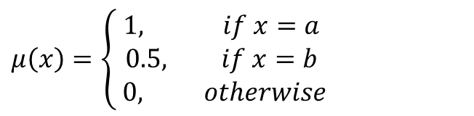
Types of Fuzzy Membership Functions (Singleton)
Singleton membership function assigns membership value 1 to particular value of x and assigns value 0 to rest of all.
$$μ\left(x\right)=\left\{\begin{aligned}1, if x=a \\ 0.5, if x=b \\ 0, otherwise\end{aligned}\right.$$
Q: What is the fuzzy value if b=60?
33

Slide 34
Fuzzy Linguistic Variables & Hedges
A linguistic variable is a fuzzy variable.
Eg:
John is tall
Linguistic variable
Linguistic value
In fuzzy expert systems, linguistic variables are used in fuzzy rules.
Eg:
IF wind is strong
THEN sailing is good
IF project_duration is long
THEN completion_risk is high
IF speed is slow
THEN stopping_distance is short
34

Slide 35

Fuzzy Linguistic Variables & Hedges
Eg:
Car speed might have the range between 0 and 220km per hour
Fuzzy subsets such as very slow, slow, medium, fast, and very fast.
Each fuzzy subset also represents a linguistic value of the corresponding linguistic variable.
A linguistic variable carries with it the concept of fuzzy set qualifiers, called hedges. Hedges are terms that modify the shape of fuzzy sets.
35

Slide 36
Fuzzy Linguistic Variables & Hedges
Hedges include adverbs such as very, somewhat, quite, more or less and slightly.
Hedges can modify verbs, adjectives, adverbs or even whole sentences.
They are used as:
All-purpose modifiers, such as very, quite or extremely.
Truth-values, such as quite true or mostly false.
Probabilities, such as likely or not very likely.
Quantifiers, such as most, several or few.
Possibilities, such as almost impossible or quite possible.
36

Slide 37
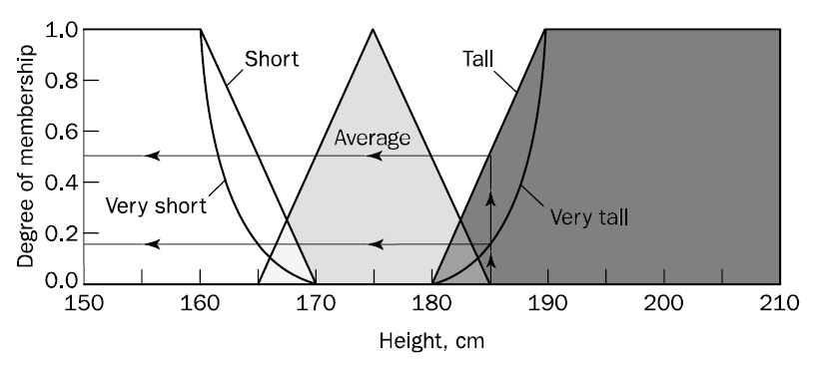
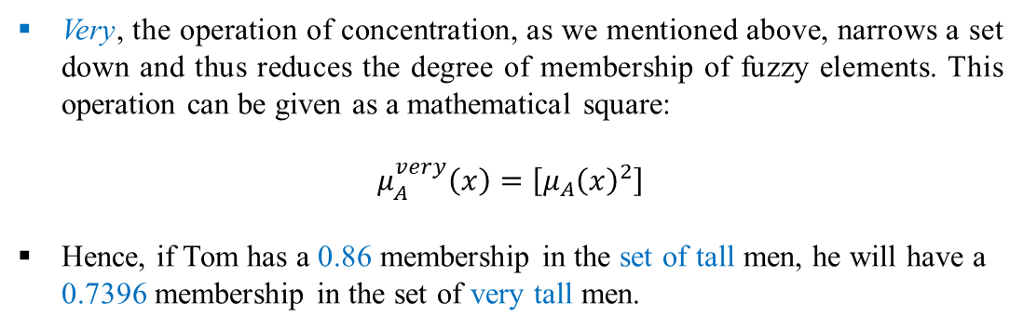
Fuzzy Linguistic Variables & Hedges
Consider, for example, a man who is 185cm tall. He is a member of the tall men set with a degree of membership of 0.5.
However, he is also a member of the set of very tall men with a degree of 0.15, which is fairly reasonable.
Figure 4.5: Fuzzy sets with very hedge
Very, the operation of concentration, as we mentioned above, narrows a set down and thus reduces the degree of membership of fuzzy elements. This operation can be given as a mathematical square:
$$μ_{A}^{very}\left(x\right)=\left[{μ_{A}\left(x\right)}^{2}\right]$$
Hence, if Tom has a 0.86 membership in the set of tall men, he will have a 0.7396 membership in the set of very tall men.
37
Source: Michael Negnevitsky. Artificial Intelligence: A Guide to Intelligent Systems. Third Edition

Slide 38
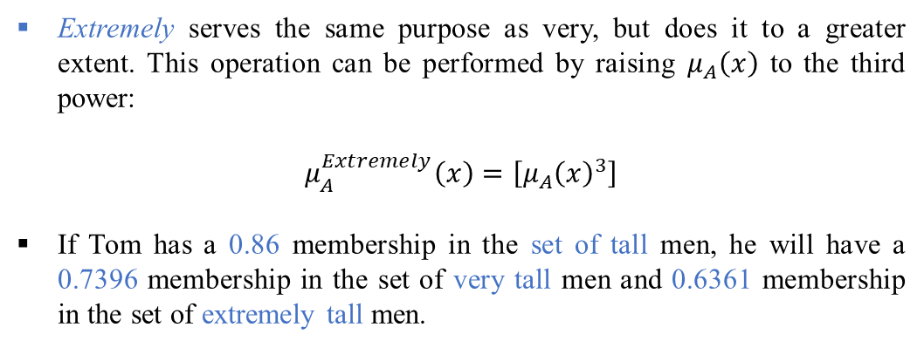
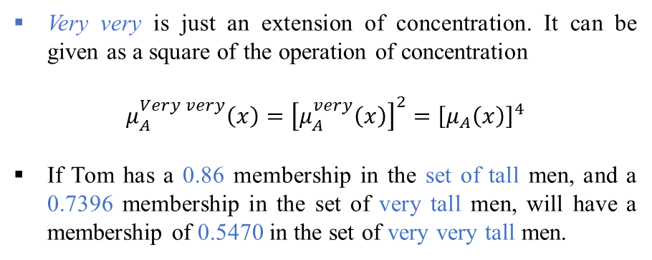
Fuzzy Linguistic Variables & Hedges
Very very is just an extension of concentration. It can be given as a square of the operation of concentration
$$μ_{A}^{Very very}\left(x\right)={\left[μ_{A}^{very}\left(x\right)\right]}^{2}={\left[μ_{A}\left(x\right)\right]}^{4}$$
If Tom has a 0.86 membership in the set of tall men, and a 0.7396 membership in the set of very tall men, will have a membership of 0.5470 in the set of very very tall men.
Figure 4.5: Fuzzy sets with very hedge
Extremely serves the same purpose as very, but does it to a greater extent. This operation can be performed by raising $μ_{A}\left(x\right)$ to the third power:
$$μ_{A}^{Extremely}\left(x\right)=\left[{μ_{A}\left(x\right)}^{3}\right]$$
If Tom has a 0.86 membership in the set of tall men, he will have a 0.7396 membership in the set of very tall men and 0.6361 membership in the set of extremely tall men.
38
Source: Michael Negnevitsky. Artificial Intelligence: A Guide to Intelligent Systems. Third Edition

Slide 39
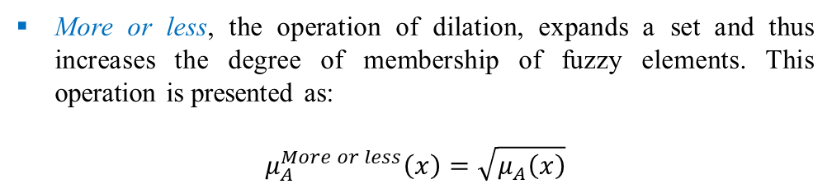
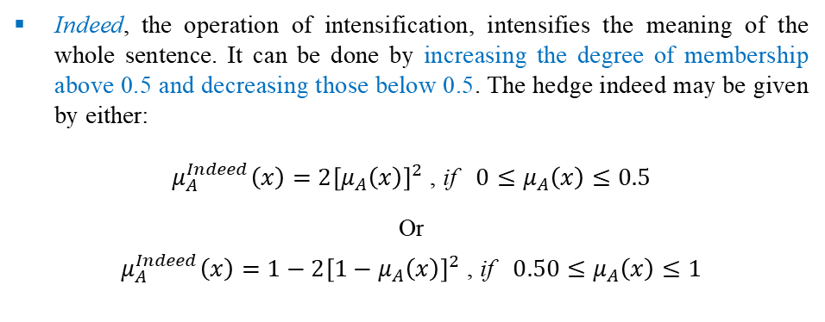
Fuzzy Linguistic Variables & Hedges
Indeed, the operation of intensification, intensifies the meaning of the whole sentence. It can be done by increasing the degree of membership above 0.5 and decreasing those below 0.5. The hedge indeed may be given by either:
$μ_{A}^{Indeed}\left(x\right)={2\left[μ_{A}\left(x\right)\right]}^{2}$ , if $0≤μ_{A}\left(x\right)≤0.5$
Or
$μ_{A}^{Indeed}\left(x\right)={1−2\left[1−μ_{A}\left(x\right)\right]}^{2}$ , if $0.50≤μ_{A}\left(x\right)≤1$
Figure 4.5: Fuzzy sets with very hedge
If Tom has a 0.86 membership in the set of tall men, he can have a 0.9608 membership in the set of indeed tall men.
In contrast, Mike, who has a 0.24 membership in tall men set, will have a 0.1152 membership in the indeed tall men set.
More or less, the operation of dilation, expands a set and thus increases the degree of membership of fuzzy elements. This operation is presented as:
$$μ_{A}^{More or less}\left(x\right)=\sqrt{μ_{A}\left(x\right)}$$
Hence, if Tom has a 0.86 membership in the set of tall men, he will have a 0.9274 membership in the set of more or less tall men.
39
Source: Michael Negnevitsky. Artificial Intelligence: A Guide to Intelligent Systems. Third Edition

Slide 40
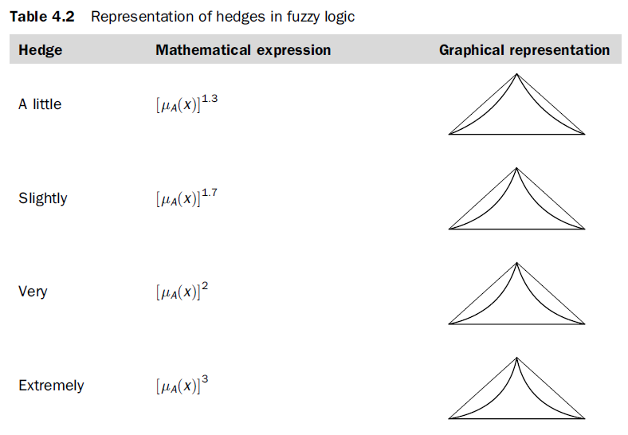
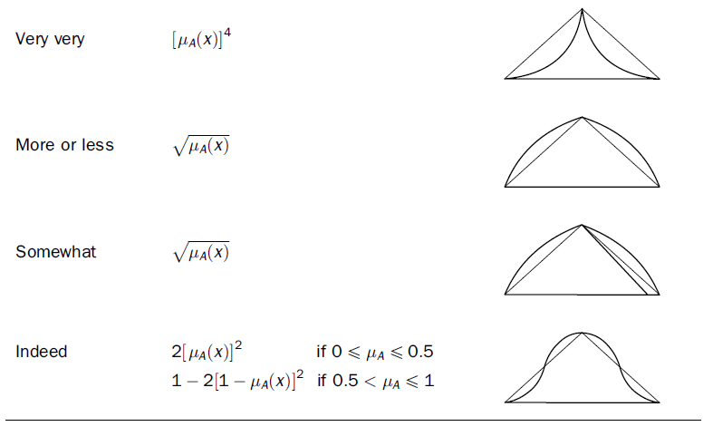
Fuzzy Linguistic Variables & Hedges
40
Source: Michael Negnevitsky. Artificial Intelligence: A Guide to Intelligent Systems. Third Edition

Slide 41
OUTLINES
01. Background of Fuzzy Logic
02. Fuzzy Sets
03. Fuzzy Membership Function
04. Fuzzy Rules
05. Fuzzy Inference/Reasoning
41

Slide 42
Fuzzy Rules
Classical Rules VS Fuzzy Rules
Fuzzy rules
42

Slide 43
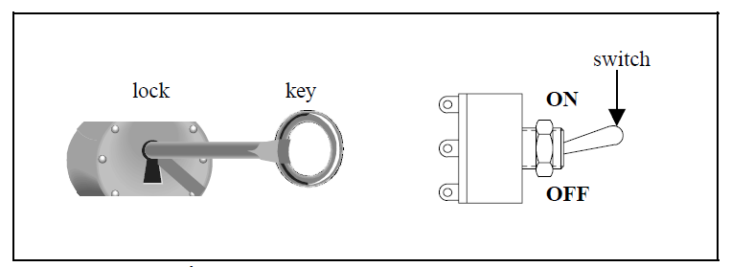
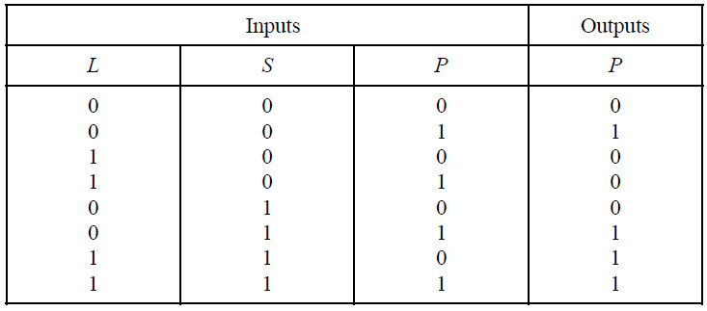
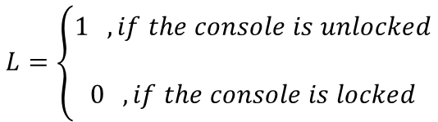
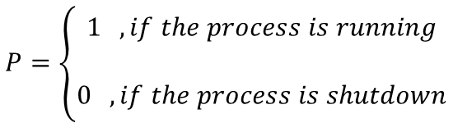
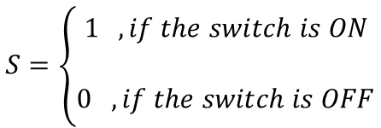
Classical Rules VS Fuzzy Rules
A classical IF-THEN rule uses binary logic, for example,
$$S=\left\{\begin{aligned}1 , if the switch is ON \\ \\ 0 , if the switch is OFF\end{aligned}\right.$$
$$P=\left\{\begin{aligned}1 , if the process is running \\ \\ 0 , if the process is shutdown\end{aligned}\right.$$
IF the key is in the lock (the console is unlocked)
AND the switch is turned to OFF
AND the process is currently running
THEN the process will be shutdown.
Figure 2.1 A console lock with a switch
$$L=\left\{\begin{aligned}1 , if the console is unlocked \\ \\ 0 , if the console is locked\end{aligned}\right.$$
L : the situation of the lock
S : the state of the switch
P : the status of the process
43
Source: D.S. Hooda and Vivek Raich. Fuzzy Logic Models and Fuzzy Control - An Introduction. First Edition

Slide 44

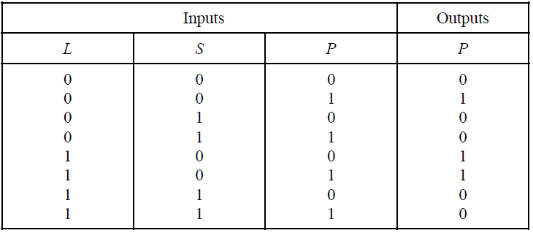
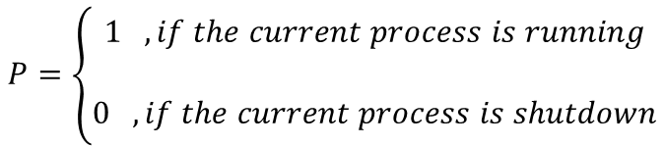
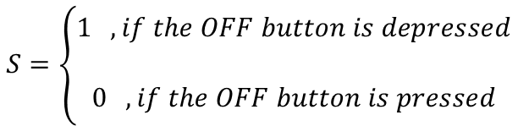
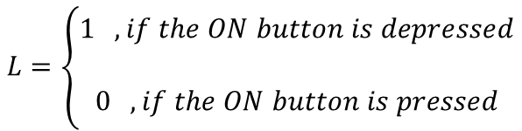
Classical Rules VS Fuzzy Rules
$$L=\left\{\begin{aligned}1 , if the ON button is depressed \\ \\ 0 , if the ON button is pressed\end{aligned}\right.$$
$$S=\left\{\begin{aligned}1 , if the OFF button is depressed \\ \\ 0 , if the OFF button is pressed\end{aligned}\right.$$
$$P=\left\{\begin{aligned}1 , if the current process is running \\ \\ 0 , if the current process is shutdown\end{aligned}\right.$$
44
Source: D.S. Hooda and Vivek Raich. Fuzzy Logic Models and Fuzzy Control - An Introduction. First Edition

Slide 45
Fuzzy Rules
Fuzzy rule can be defined as a conditional statement in the form:
IF x is A
THEN y is B
where x and y are linguistic variables; and A and B are linguistic values determined by fuzzy sets on the universe of discourses X and Y, respectively.
We can also represent the stopping distance rules in a fuzzy form:
Rule: 1
IF speed is fast
THEN stopping_distance is long
Rule: 2
IF speed is slow
THEN stopping_distance is short
antecedent or premise
consequence or conclusion
Here the linguistic variable speed also has the range (the universe of discourse) between 0 and 220 km/h, but this range includes fuzzy sets, such as slow, medium and fast.
The universe of discourse of the linguistic variable stopping_distance can be between 0 and 300m and may include such fuzzy sets as short, medium and long. Thus fuzzy rules relate to fuzzy sets.
45

Slide 46
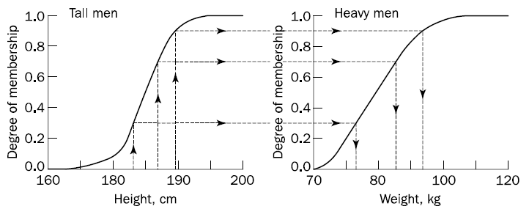
Fuzzy Rules
Eg:
Figure 4.8 Fuzzy sets of tall and heavy men
These fuzzy sets provide the basis for a weight estimation model. The model is based on a relationship between a man’s height and his weight, which is expressed as a single fuzzy rule/ monotonic selection:
IF height is tall
THEN weight is heavy
46
Source: Michael Negnevitsky. Artificial Intelligence: A Guide to Intelligent Systems. Third Edition

Slide 47
Fuzzy Rules
Q: Can the antecedent of a fuzzy rule have multiple parts?
IF project_duration is long
AND project_staffing is large
AND project_funding is inadequate
THEN risk is high
IF service is excellent
OR food is delicious
THEN tip is generous
47

Slide 48
Fuzzy Rules
Q: Can the consequent of a fuzzy rule have multiple parts?
IF temperature is hot
THEN hot_water is reduced;
cold_water is increased
In this case, all parts of the consequent are affected equally by the antecedent
48

Slide 49
OUTLINES
01. Background of Fuzzy Logic
02. Fuzzy Sets
03. Fuzzy Membership Function
04. Fuzzy Rules
05. Fuzzy Inference/Reasoning
49

Slide 50
Fuzzy Inference/ Reasoning
Mamdani style
Takagi-Sugeno style
50

Slide 51
Mamdani Style
The most commonly used fuzzy inference technique is the so-called Mamdani method.
In 1975, Professor Ebrahim Mamdani of London University built one of the first fuzzy systems to control a steam engine and boiler combination (Mamdani and Assilian, 1975). He applied a set of fuzzy rules supplied by experienced human operators.
Consists of 4 steps:
Fuzzification of the input variables
Rule Evaluation
Aggregation of the rule outputs
Defuzzification
Mamdani-style inference requires us to find the centroid of a two-dimensional shape by integrating across a continuously varying function
51

Slide 52
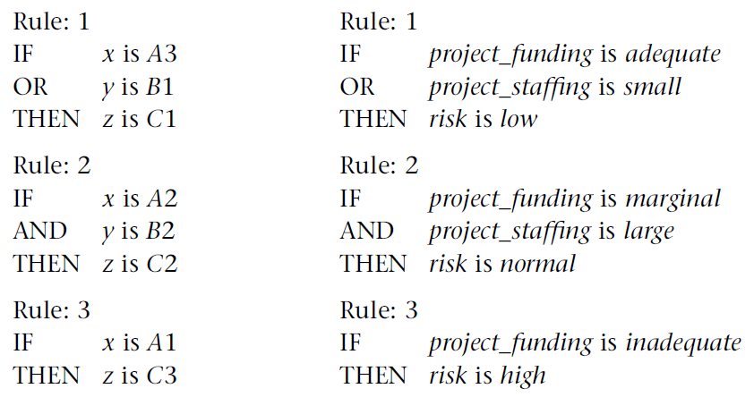
Mamdani Style
Case study:
linguistic variables (x, y, z)- project_funding, project_staffing, risk
linguistic values (project_funding; A1, A2, A3)- inadequate, marginal, adequate
linguistic values (project_staffing; B1, B2)- small, large
linguistic values (risk, C3)- high
52
Source: Michael Negnevitsky. Artificial Intelligence: A Guide to Intelligent Systems. Third Edition

Slide 53
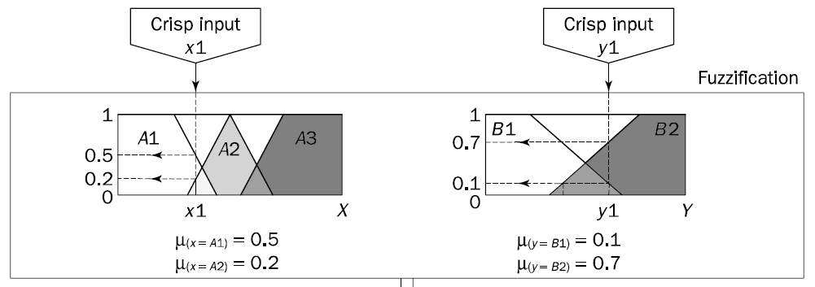
Mamdani Style- Step 1: Fuzzification of the input variables
The first step is to take the crisp inputs, x1 and y1 (project funding and project staffing), and determine the degree to which these inputs belong to each of the appropriate fuzzy sets.
53
Source: Michael Negnevitsky. Artificial Intelligence: A Guide to Intelligent Systems. Third Edition

Slide 54


Mamdani Style- Step 2: Rule Evaluation
The second step is to take the fuzzified inputs, 𝜇_{((𝑥=𝐴1))=}0.5, 𝜇_{((𝑥=𝐴1))=}0.2, 𝜇_{((𝑦=𝐵1))}=0.1 and 𝜇_{((𝑦=𝐵2))}=0.7, and apply them to the antecedents of the fuzzy rules.
If a given fuzzy rule has multiple antecedents, the fuzzy operator (AND or OR) is used to obtain a single number that represents the result of the antecedent evaluation.
This number (the truth value) is then applied to the consequent membership function.
To evaluate the disjunction of the rule antecedents, the OR fuzzy operation is used. Typically, fuzzy expert systems make use the classical fuzzy operation union.
Similarly, in order to evaluate the conjunction of the rule antecedents, the AND fuzzy operation intersection is used.
$μ_{A∩B}\left(x\right)=max\left[μ_{A}\left(x\right),μ_{B}\left(x\right)\right]$= $μ_{A}\left(x\right)∪μ_{B}\left(x\right)$
$μ_{A∩B}\left(x\right)=min\left[μ_{A}\left(x\right),μ_{B}\left(x\right)\right]$= $μ_{A}\left(x\right)∩μ_{B}\left(x\right)$
54

Slide 55

Mamdani Style- Step 2: Rule Evaluation
55

Slide 56
Mamdani Style- Step 2: Rule Evaluation
Now the result of the antecedent evaluation can be applied to the membership function of the consequent.
In other words, the consequent membership function is clipped or scaled (also known as correlation minimum) to the level of the truth value of the rule antecedent. Since the top of the membership function is sliced, the clipped fuzzy set loses some information.
However, clipping is still often preferred because it involves less complex and faster mathematics and generates an aggregated output surface that is easier to defuzzify.
Also, scaling offers a better approach for preserving the original shape of the fuzzy set.
The original membership function of the rule consequent is adjusted by multiplying all its membership degrees by the truth value of the rule antecedent.
56

Slide 57

Mamdani Style- Step 2: Rule Evaluation
Figure 4.12 Clipped (a) and scaled (b) membership functions
57
Source: Michael Negnevitsky. Artificial Intelligence: A Guide to Intelligent Systems. Third Edition

Slide 58

Mamdani Style- Step 3: Aggregation of the rule outputs
Aggregation is the process of unification of the outputs of all rules. In other words, we take the membership functions of all rule consequents previously clipped or scaled and combine them into a single fuzzy set.
Thus, the input of the aggregation process is the list of clipped or scaled consequent membership functions, and the output is one fuzzy set for each output variable.
58
Source: Michael Negnevitsky. Artificial Intelligence: A Guide to Intelligent Systems. Third Edition

Slide 59


Mamdani Style- Step 4: Defuzzification
Fuzziness helps us to evaluate the rules, but the final output of a fuzzy system has to be a crisp number.
The input for the defuzzification process is the aggregate output fuzzy set and the output is a single number.
How do we defuzzify the aggregate fuzzy set?
Centroid Technique: Centre of gravity
$$COG= \frac{\int_{b}^{a}{μ_{A}\left(x\right)xdx}}{\int_{a}^{b}{μ_{A}\left(x\right)dx}}$$
Figure 4.13 The centroid method of defuzzification
59
Source: Michael Negnevitsky. Artificial Intelligence: A Guide to Intelligent Systems. Third Edition

Slide 60


Mamdani Style- Step 4: Defuzzification
Thus, the result of defuzzification, crisp output z1, is 67.4. It means, for instance, that the risk involved in our ‘fuzzy’ project is 67.4 percent.
Figure 4.14 Defuzzifying the solution variable’s fuzzy set
60

Slide 61


Takagi-Sugeno Style
Introduced by Michio Sugeno, the ‘Zadeh of Japan’, in 1985 (Sugeno, 1985).
Use a single spike, a singleton, as the membership function of the rule consequent.
Singleton, or more precisely a fuzzy singleton, is a fuzzy set with a membership function that is unity at a single particular point on the universe of discourse and zero everywhere else.
Sugeno changed only a rule consequent- a mathematical function of the input variable. The most commonly used zero-order Sugeno fuzzy model applies fuzzy rules
Linguistic variables- x,y,z
Fuzzy sets- A,B
Mathematical function- f(x,y)
61

Slide 62



Takagi-Sugeno Style
The aggregation operation simply includes all the singletons.
Use the formula of weighted average (WA):
$$WA=\frac{μ\left(k1\right)×k1+μ\left(k2\right)×k2+μ\left(k3\right)×k3}{μ\left(k1\right)+μ\left(k2\right)+μ\left(k3\right)}$$
$$WA=\frac{0.1×20+0.2×50+0.5×80}{0.1+0.2+0.5}=65$$
62

Slide 63
Conclusion
Fuzzy logic is a logic that describes fuzziness. As fuzzy logic attempts to model humans’ sense of words, decision making and common sense, it is leading to more human intelligent machines.
Fuzzy logic is a set of mathematical principles for knowledge representation based on degrees of membership rather than on the crisp membership of classical binary logic. Unlike two-valued Boolean logic, fuzzy logic is multivalued.
Fuzzy inference is a process of mapping from a given input to an output by using the theory of fuzzy sets. The fuzzy inference process includes four steps: fuzzification of the input variables, rule evaluation, aggregation of the rule outputs and defuzzification.
Building a fuzzy expert system is an iterative process that involves defining fuzzy sets and fuzzy rules, evaluating and then tuning the system to meet the specified requirements.
63

Slide 64
References
Michael Negnevitsky. (2019). Artificial Intelligence: A Guide to Intelligent Systems. Third Edition
D.S. Hooda and Vivek Raich. (2017). Fuzzy Logic Models and Fuzzy Control - An Introduction. First Edition
Mehmed Kantardzic. (2020). Data Mining Concepts, Models, Methods and Algorithms. Third Edition
Peter Norvig and Stuart Russell. (2021). Artificial Intelligence: A Modern Approach. Fourth Edition
64

